Slide 1
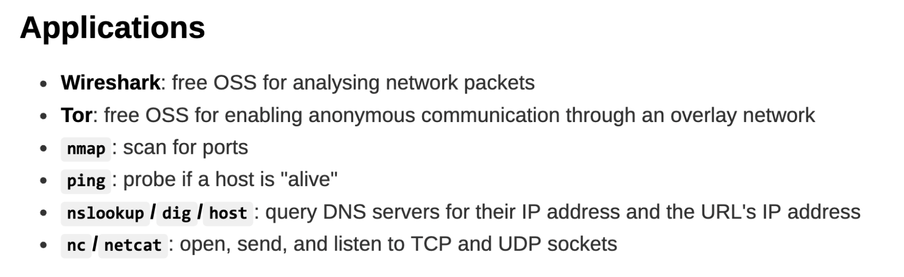
UNIX Commands and tools
Wireshark
packet capture and analysis
detect unusual communication patterns, e.g. if laptop is communicating with a botnet
capture information sent over http (e.g. password)
nmap
Real time information of a network
Detailed information of all the IPs activated on your network
Find number of ports open in a network
Provide the list of live hosts
Port, OS and Host scanning
chmod
change the permissions of a file or directory on a Unix or Unix-like system
nslookup
finds a domain name's IP address or DNS record, or performs a reverse DNS lookup to find the domain name for a given IP address
ping
tests if a device is reachable on an IP network
Web attacks
XSS (difficult to prevent)
Takes advantage of the trust a website has for a user’s input and browser
Tricks victims into performing an action on a website they are authenticated to
Client attacks another client by exploiting victim client’s trust of a server
Reflection/Non-persistent XSS: click on url which contains targeted website and script
Persistent/Stored XSS: script is stored in targeted website
SQL injection
Client attacks a server
Attacks data-driven web applications target backend database servers
Drive-by download
Server attacks a client
XSRF (easier to prevent than XSS)
Client attacks another client by exploiting a server’s trust of the victim client
Victim first logs in and authenticate with involved web server
Proxy re-encryption
Relaying network attacks a client
Cookie
sent by the server in the response of a http request, browser permanently stores the cookie
When client revisits the website, browser automatically sends the cookie back to the server
COOKIE IS GOOD
Same origin policy
origin: protocol, hostname, port number
Cookies are sent back only to “same origin” (sent to the server which is the origin of the cookie)
Script in webpage A can access cookies stored by another webpage B only if both A and B have the same origin
Differing definitions of “same-origin”
XSS: malicious script is coming from the same-origin (the victim clicked on it) – privilege escalation
How possible to steal cookies even if “same-origin” policy is enforced -> after processing and rendering the comment, the malicious code is now part of the legitimate HTML rendered
Typosquatting attack
- Purposely uses misspelled domains for malicious purpose
FORWARD SECRECY
in modern TLS protocols (e.g., TLS 1.3) ensures that session keys cannot be intercepted or reconstructed by M, even with Wi-Fi control.
WPA2 does not ensure forward secrecy (but question may assume)
RSA-based authenticated key-exchange does not achieve forward secrecy but DH-based does
http vs https (https = http on top of TLS)
http – transmit in plaintext, unauthorised parties can easily access and read them over the internet
https - transmit all data in encrypted form, third parties cannot intercept the data over the network
WPA2 personal – only one common password for all users
Enterprise wifi – each user has a login and password
DNS spoofing
Attacker sits below physical layer
Can sniff and inject spoofed data into communication channel
Cannot remove and modify data sent
Attacker’s reply: “ip address is…” reaches first
Reflection: numerous fake queries + several DNS resolvers replying back simultaneously
ARP poisoning
table: associates port to mac address, look up table resolve to port
poison: inform other node false mac address
Denial of Service (DOS)
Prevention of authorised to resources/delaying of time critical operations affects availability
Reflection: attacker send request to intermediate nodes -> send overwhelming traffic to victim
Amplification: size of traffic victim received vs size of traffic sent by attacker
Clicking on spoofed website with valid certificate
Browser contained vuln and did not verify certificate properly
Domain name changed owner, spoofed website operated by previous owner
Private key stolen after certificate expired, rightful owner did not revoke certificate
Laptop previously accepted self signed (expired) certificate of malicious CA
Reasons why certificate is not valid
Expired
Signed by unknown CA
Revoked due to keys being cracked/compromised
Website changed ownership and ex owner has private key
Signature can be forged if uses SHA1 (collision found)
Unless otherwise stated, MITM can sniff, spoof, modify, drop data

Slide 2
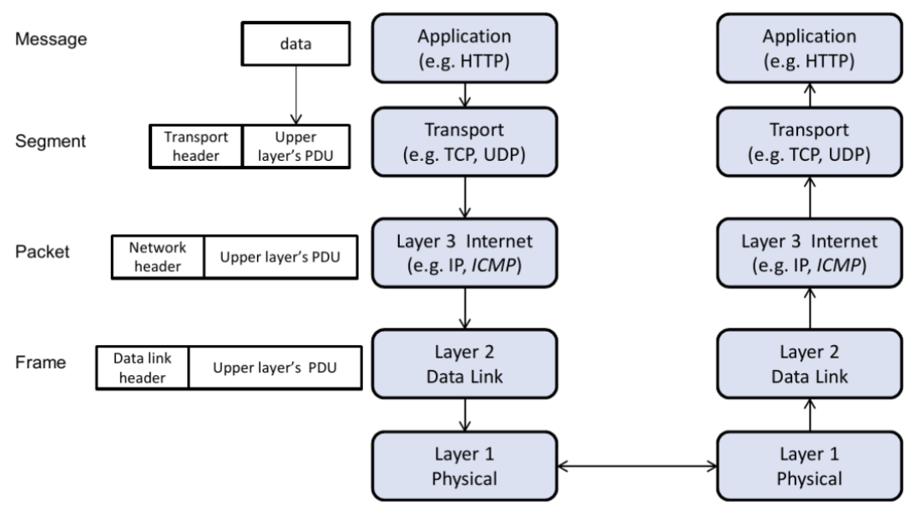
Protocol that protects layer k also protects information in layer k+1 (and above)
ARP poisoning occurs at data link layer (Layer 2)
ARP MITM is capable of drop, sniff, spoof, modify (all)
VPN operates below IP layer
https is on top of data link layer
WPA2 provides protection in Link and Physical layer
Wi-fi owner can see all connected devices’ MAC addresses through ARP
Physical Layer (Layer 1):
transmission of raw bits over a physical medium (e.g., Wi-Fi signals, Ethernet cables).
signal jamming or eavesdropping via specialized hardware can occur.
raw interception of wireless signals yields encrypted data, not plaintext.
Data Link Layer (Layer 2):
Handles MAC addressing and data framing for nodes on the same network
ARP (Address Resolution Protocol) operates at this layer -> ARP poisoning/spoofing
WPA2 encrypts communication between clients and the router at this layer. Even if both Alice and Bob know the Wi-Fi password, each session generates a unique session key. This prevents Bob from decrypting Alice’s Layer 2 frames unless Bob becomes a MITM by other means (e.g., ARP attack).
Network Layer (Layer 3):
IP addressing and routing packets between devices/networks. Protocols like IPv4 and IPv6 operate here. IPSec protects this layer
MITM at this layer often involves IP spoofing or intercepting IP packets via rogue routers.
WPA2’s encryption happens below this layer, so the packets’ contents are protected. However, attackers may still manipulate routing if they compromise Layer 2.
ARP poisoning indirectly enables MITM attacks at this layer, as manipulated ARP entries redirect IP packets.
Transport Layer (Layer 4):
Provides reliable end-to-end communication (e.g., TCP/UDP).
TLS operates here, protects this layer and above
If VPN operates here, DNS request is routed to VPN server and MITM can only get frames encrypted by VPN
MITM attacks at this layer include session hijacking, where an attacker intercepts or injects TCP packets.WPA2 encrypts the data in frames, intercepted TCP streams appear as encrypted gibberish without the session key.
ARP poisoning enables MITM attacks that manipulate or eavesdrop on transport-layer sessions.
Session Layer (Layer 5):
Manages and controls sessions between applications. Protocols like SSL/TLS operate here.
MITM involves intercepting or spoofing session tokens. For instance, attackers could impersonate a legitimate server during the handshake process.
WPA2 protects underlying data, but if TLS is compromised (e.g., via rogue certificates), MITM can succeed.
ARP poisoning could enable session hijacking by redirecting encrypted traffic.
Presentation Layer (Layer 6):
Handles data encoding, encryption, and compression.
Application Layer (Layer 7):
Interfaces directly with user applications (e.g., HTTP/HTTPS, DNS).
MITM here involves intercepting or spoofing application-layer protocols. For instance, DNS spoofing redirects Alice to a malicious site.
WPA2 encryption does not directly protect against DNS-level manipulation; separate DNSSEC or application-layer encryption (TLS) is needed.
ARP poisoning allows attackers to spoof DNS servers or web servers by misrouting requests.

Slide 3
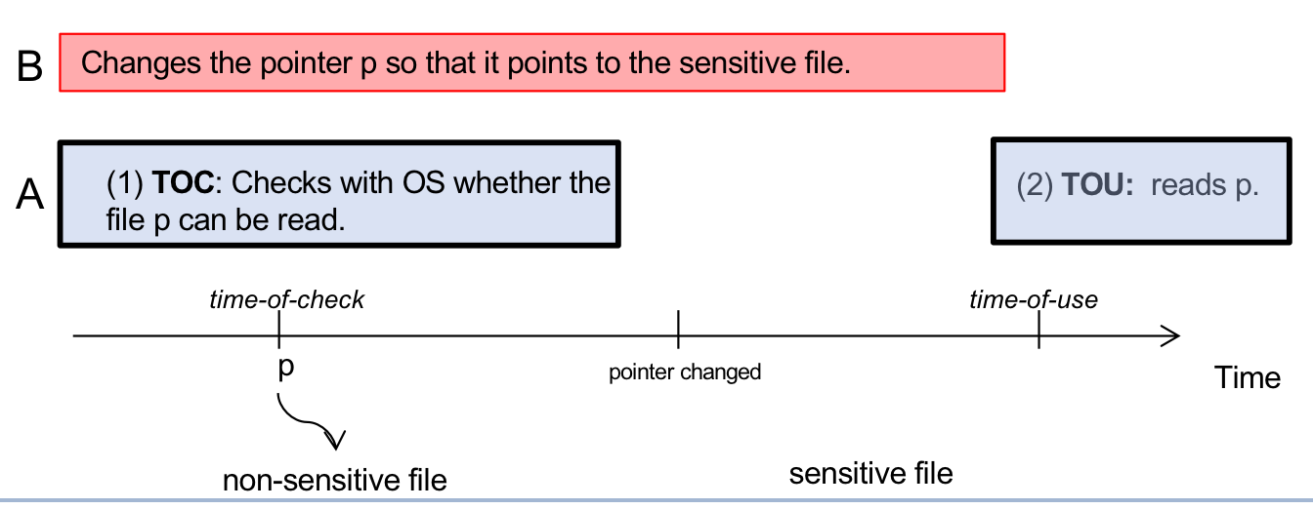
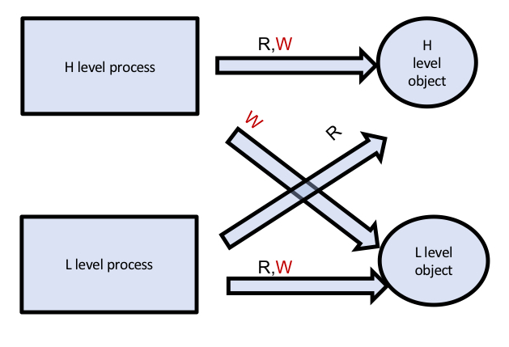
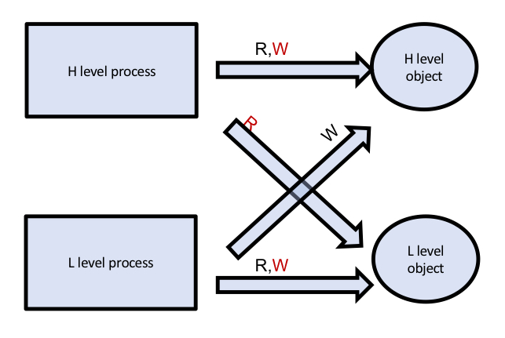
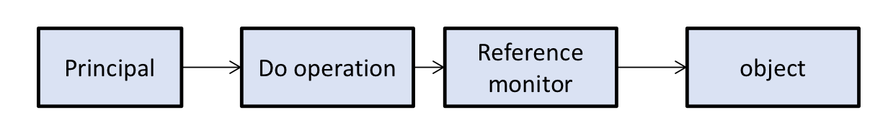
Secure Programming
unsigned int has a max value of 255 (2^8), anything more than 255 will cause it to overflow and wrap around
(256%256 = 0) and value will become 0
gets vs fgets
gets(variable) - terminates its reading session as soon as it encounters a newline character.
fgets(*str, n, *stream) - terminates reading whenever it encounters a newline character, also stops when EOF is reached or even if the string length exceeds the specified limit, n-1.
strlen/strcopy/strcat: processes whole string including null terminator
printf(): obtain more information, crash program using %s (execution integrity), modify memory content using %n (memory integrity)
Canaries
Secrets inserted at carefully selected memory locations during runtime, check during runtime that the values are not being modified
Detect (stack) overflow -> consecutive memory locations are overrun
Recompile using canary flags
C/C++ do not perform bound check at runtime
Access Control
Mandatory Access Control
system-wide policy decides the rights, must be followed by everyone in the system
Users cannot change policies themselves
Discretionary Access Control
Owner of the object decides the rights
Linux uses DAC
Group
Subjects are divided into groups
Owner specify rights for owner, group, world
Can only be created by root
Role-based Access Control
Role is associated with a collection of procedures
Access rights to certain objects required
Privilege
If a subject can access an object, another object with higher privilege can also access the object
Protection Rings
Object with smaller number is more important (lower ring number -> higher privilege)
Subject cannot access object with smaller ring number
UNIX – user and superuser
Principle of Least Privilege
- Access rights that are not required to complete the role will not be assigned
TOCTOU – race condition when multiple processes in parallel access a piece of shared data in a way that the outcome depends on the sequence of accesses
Biba (Integrity)
No malicious information going up
Perform input validation
Whitelist (may have false positive/negative)
Blacklist (may have false negative)
Difficult to design a complete + accept all valid filter
Access Control List
Stores the access rights to an object
Difficult to obtain the list of objects a particular subject has access to
UNIX employs ACL
Capabilities
Stores the access rights a subject has to an object
Difficult to obtain the list of subjects who have access to a particular object
Access Control Matrix
Specify access right of a particular principal to a particular object
All pairs of principals and objects
Table is very large
Principal (subject) wants to access an object with some operation. Reference monitor either grants or denies access
Principal: human user
Subject: entities in system that operate on behalf of principals
Observe: read
Alter: write/delete/change properties
Action: execute
No write up – prevents insider from poisoning upper level data
No read down – prevents insider from reading data poisoned by lower level
Bell-LaPadula (Confidentiality)
No sensitive information leaking down
No read up – prevents lower level from getting info in higher level
No write down – prevents insider from passing information to lower level

Slide 4
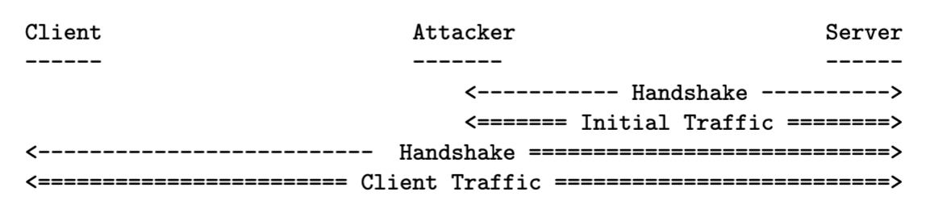
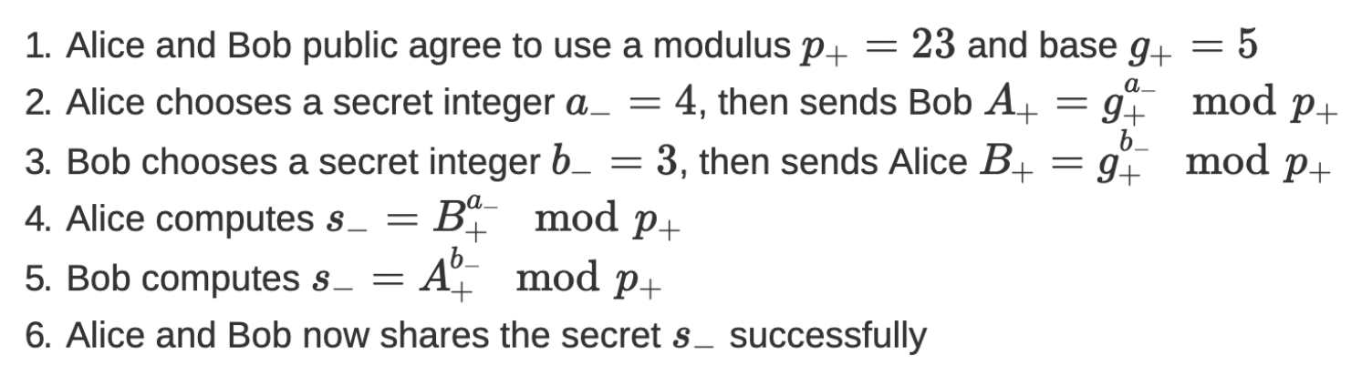
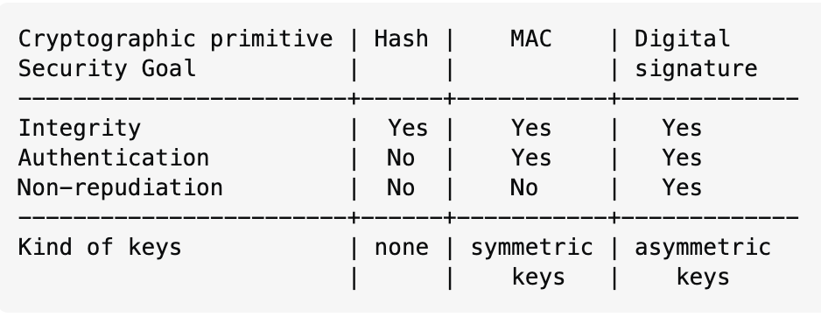
Past quiz answers
Known vulnerabilities
CVE (Common Vulnerabilities and Exposures)
Public repository containing discovered vulnerabilities
List of entries—each containing an identification number, a description, and at least one public reference
Zero-day vulnerabilities
Discovered but not yet published
If attacker deploy attacks on zero-day vulnerabilities, the victims have “zero-day” to react.
NIST (National Institute of Standards and Technology)
Linux penguin shows that ECB mode leaks information
Smartcards illustrate the concepts of vulnerability of having short key, Kerckhoff’s principle, oracle, 2FA
LT’s desktop has risk of hardware keylogger/cached info
Consider attackers who want to achieve an easier goal, and have more capabilities and information
ATM skimmer demonstrates a way to steal credentials
Key strength of 6x DES is 168 bit (1x is 56)
Entropy of password = log_2(no. of combinations)
*randomness of the source*
Strict definition of 2FA: Face + fingerprint is NOT 2FA, password + confirmation email is NOT 2FA
Factors:
Something you know
Something you have
Something you are
Certificate in PKI: Binding of “name” with “public key”, certified by an authority
Name in a certificate can be IP address, student ID, wildcard domain name, company name, email address
Forward secrecy is limited by the assumption of a weaker attack, attackers can only passively collect traffic (not MITM), can only steal the key but not modify the algorithm
DNS spoofing attack is possible due to the lack of protection of integrity -> DNS responses lack cryptographic integrity checks
Packet that contains the server’s certificate is Server Hello, from webserver to computer
Data is sent to DNS server, first address in nslookup
Wi-fi owner can see:
MAC address
IP address
WPA session key
ARP table
Number of packets sent
[CANNOT] see TLS session key
Other user connected to same Wi-fi can see:
MAC address
IP address
ARP poisoning
Number of packets
Other user who doesn’t know the password
MAC address
SOC – Security Operations Center
SOC Level 2 – auditing procedure/compliance standard
TLS handshake uses unilateral authentication server’s identity is verified but the client’s identity is not -> client does not have to prove identity to server -> allow re-nego
OVERALL authentication process: mutual authentication
Hash vs mac:
Hash used to guarantee the integrity of data, MAC guarantees integrity AND authenticity
Hash gives no information about the sender
MAC – recipient can authenticate that the sender has the shared secret key
TLS Renegotiation attack
Client verifies the Server in unilateral authentication
Authentication token is stored in the cookie
Does NOT compromise confidentiality
Attacker is MITM below the IP/Network layer
Client and attacker obtain Server’s public key from Server’s certificate (sent during TLS handshake)
MITM is able to inspect, inject, modify IP{ packet
Prevent re-nego attack:
Disable re-nego (affect availability)
apply MAC using the secret key previously established with Client
CIA triad: Confidentiality, Integrity, Availability
Achieve confidentiality -/-> achieve authenticity
Designs of various symmetric key encryption schemes
• One-time pad. “unbreakable” even if attacker has sufficient time to exhaustively search.
• Stream Cipher. xor’ing with a “pseudo-random” string.
IV of a stream cipher must not be repeated
• Block Cipher. Mode of operations.
• CBC: provides some form of integrity.
• CTR: stream cipher
• Crucial role of IV. (need randomness to have indistinguishability)
• Make the encryption probabilistic. • How it is deployed. Why it is important.
Diffie-Hellman Key Exchange
Any hash function has many collisions!!! but computationally infeasible to find collision

